Slide 1


Eduardo Dietrich Zimmermann
21/09/2025

Slide 2

Outline
Executive Summary
Introduction
Methodology
Results
Conclusion
Appendix

Slide 3
Executive Summary
Objective: Analyze SpaceX launch data to identify factors influencing mission success and build predictive models.
Approach:
Data collected via SpaceX REST API and web scraping.
Data wrangling for consistency and missing value handling.
Exploratory Data Analysis (EDA) using visualizations and SQL.
Interactive analytics with Folium maps and Plotly Dash dashboard.
Predictive analysis with classification models.
Key Findings:
Success rate of launches improved significantly after 2015 (>80% success in recent years).
Payload mass and launch site strongly correlated with mission outcomes.
The Logistic Regression achieved the best accuracy (83,33%).
Impact: Provides insights for forecasting launch outcomes and guiding decision-making for future missions.

Slide 4
Introduction
Background: SpaceX is a leader in commercial spaceflight, aiming to reduce costs and enable Mars colonization.
Problem Statement: Which factors influence the success of Falcon 9 launches?
Guiding Questions:
Does payload mass affect mission success?
Do different launch sites have higher/lower success rates?
How have success rates evolved over time?
Can we predict future launch success using historical data?

Slide 5

Section 1

Slide 6
Methodology
Executive Summary
Data Collection:
Retrieved launch records from SpaceX REST API.
Performed web scraping for supplementary mission details.
GitHub Repo: https://github.com/eduardozimmermann1/PythonCapstone/tree/main
Data Wrangling:
Standardized column names, handled missing values, normalized data types.
Created derived variables (e.g., success indicator).
EDA:
Visual exploration (scatter plots, bar charts, line charts).
SQL queries for structured insights.
Interactive Analytics:
Folium maps to visualize launch sites and outcomes.
Plotly Dash for interactive filtering and payload analysis.
Predictive Analysis:
Built classification models: Logistic Regression, Decision Tree, Random Forest, KNN, SVM.
Compared performance to select the best predictor.

Slide 7
Data Collection
Queried the SpaceX public REST API (/v4/launches/past)
Retrieved structured launch data in JSON format (via API response)
Converted JSON response directly into Pandas DataFrame
Extracted relevant fields: flight number, date, payload mass, customer, booster version, outcome
Normalized nested fields for consistency
Ensured reproducibility by storing processed dataset in the project repository

Slide 8
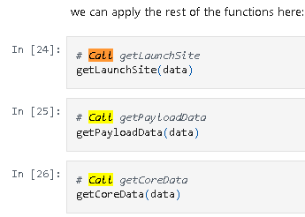
Data Collection – SpaceX API
Present your data collection with SpaceX REST calls using key phrases and flowcharts
GitHub URL of the completed SpaceX API calls notebook, as an external reference and peer-review purpose: <https://github.com/eduardozimmermann1/PythonCapstone/blob/main/jupyter-labs-spacex-data-collection-api_modified%20(1).ipynb>

Slide 9
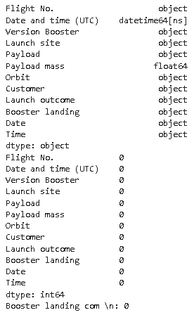
Data Collection - Scraping
Present your web scraping process using key phrases and flowcharts
GitHub URL of the completed web scraping notebook, as an external reference and peer-review purpose: < https://github.com/eduardozimmermann1/PythonCapstone/tree/Webscraping>

Slide 10
Data Wrangling
Describe how data were processed
You need to present your data wrangling process using key phrases and flowcharts
GitHub URL of completed data wrangling related notebooks, as an external reference and peer-review purpose: < https://github.com/eduardozimmermann1/PythonCapstone/tree/Wranglig>

Slide 11
EDA with Data Visualization
Summarize what charts were plotted and why you used those charts
GitHub URL of completed EDA with data visualization notebook, as an external reference and peer-review purpose: < https://github.com/eduardozimmermann1/PythonCapstone/tree/EDAVisualization>

Slide 12
EDA with SQL
Using bullet point format, summarize the SQL queries you performed
GitHub URL of completed EDA with SQL lab, as an external reference and peer-review purpose: < https://github.com/eduardozimmermann1/PythonCapstone/tree/EDAwithSQLPeerGraded>

Slide 13
Build an Interactive Map with Folium
Summarize what map objects such as markers, circles, lines, etc. you created and added to a folium map
Explain why you added those objects
GitHub URL of completed Interactive Map with Folium, as an external reference and peer-review purpose: < https://github.com/eduardozimmermann1/PythonCapstone/tree/VisualAnalyticswithFoliumLab>

Slide 14
Build a Dashboard with Plotly Dash
Summarize what plots/graphs and interactions you have added to a dashboard
Explain why you added those plots and interactions
GitHub URL of completed Dashboard with Plotly Dash, as an external reference and peer-review purpose: < https://github.com/eduardozimmermann1/PythonCapstone/tree/DashboardwithPlotly>

Slide 15
Predictive Analysis (Classification)
Summarize how you built, evaluated, improved, and found the best performing classification model
You need present your model development process using key phrases and flowchart
GitHub URL of completed predictive analysis lab, as an external reference and peer-review purpose: < https://github.com/eduardozimmermann1/PythonCapstone/tree/MachineLearningPredictionLab >

Slide 16
Results
Exploratory data analysis results:
All Launch Sites: Extracted unique site names.
CCA Sites: Filtered records beginning with CCA
Total Payload by NASA Missions: Quantified NASA contributions.
Average Payload for F9 v1.1: Derived mean payload for specific booster.
First Successful Ground Landing: Identified milestone event date.
Drone Ship Landings with Payload 4000–6000 kg: Extracted qualifying missions.
Total Successful vs. Failed Outcomes: Showed improvement over time.
Ranking Landing Outcomes (2010–2017): Revealed dominant patterns.
Flight Number vs. Launch Site: Success rate increases with higher flight numbers (experience effect).
Payload vs. Launch Site: Larger payloads associated with variable success rates across sites.
Success Rate vs. Orbit Type: Certain orbits (e.g., GTO, LEO) show distinct success ratios.
Yearly Trend: Success rate improves steadily, especially after 2015.
Interactive analytics results:
Global Map Markers: All launch sites geolocated.
Color-Labeled Outcomes: Successes in green, failures in red.
Distance to Coastline Example: Measured proximity of launch pads to coastlines, highways, railways.
Launch Success by Site (Pie Chart): KSC LC-39A achieved ~77% success.
Payload vs. Outcome Scatter (Interactive Slider): Certain payload ranges show higher probability of success.
Filters Enabled: Interactive selection by site, payload range, and booster version.
Predictive analysis results:
Classification Accuracy (Bar Chart): Logistic Regression outperformed others with highest accuracy (0,8333%).
Confusion Matrix of Best Model: Demonstrates strong precision and recall on positive (success) outcomes.
Insight: Model can reasonably predict whether a future mission will succeed based on historical features..

Slide 17

Section 2

Slide 18
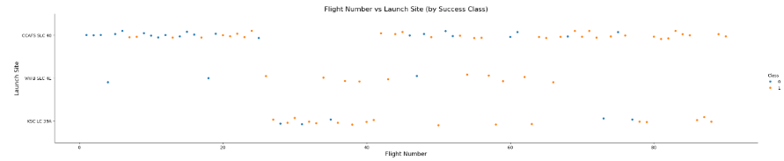
Flight Number vs. Launch Site
Show a scatter plot of Flight Number vs. Launch Site
CCAFS SLC40 had more flights than others.

Slide 19
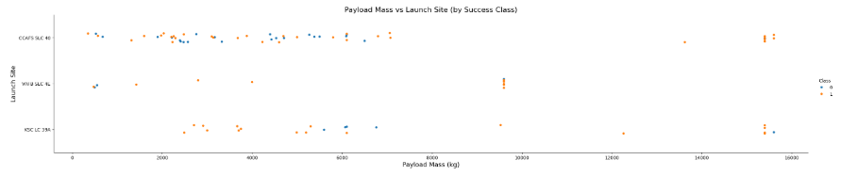
Payload vs. Launch Site
Show a scatter plot of Payload vs. Launch Site
Payload Mass less than 7500 Kg concentrates most launch sites.

Slide 20
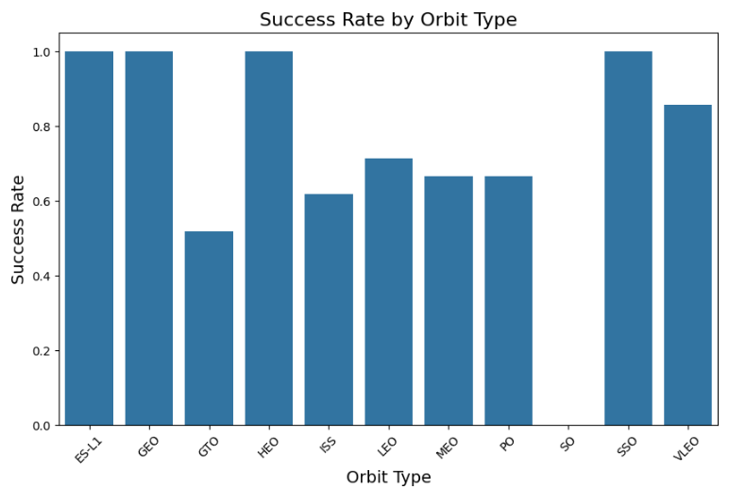
Success Rate vs. Orbit Type
Show a bar chart for the success rate of each orbit type
ES-L1, GEO, HEO, and SSO, success rate of 100%.

Slide 21
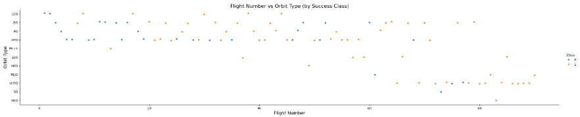
Flight Number vs. Orbit Type
Show a scatter point of Flight number vs. Orbit type
Some orbit types started later than others.

Slide 22
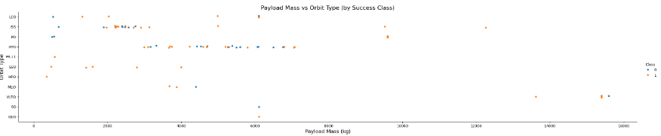
Payload vs. Orbit Type
Show a scatter point of payload vs. orbit type
Paylod Mass 4000 to 6000 concentrates most orbit types.

Slide 23
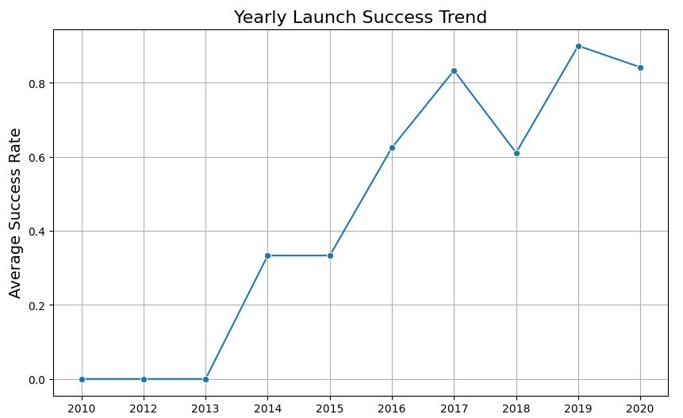
Launch Success Yearly Trend
Show a line chart of yearly average success rate
2013 to 2014: increased;
2014 to 2015: neutral;
2015 to 2017: increased;
2017 to 2018: decreased;
2018 to 2019: increased;
2019 to 2020: decreased;
Overall: increased average success rate.

Slide 24
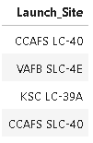
All Launch Site Names
Find the names of the unique launch sites
4 unique launch site names found

Slide 25
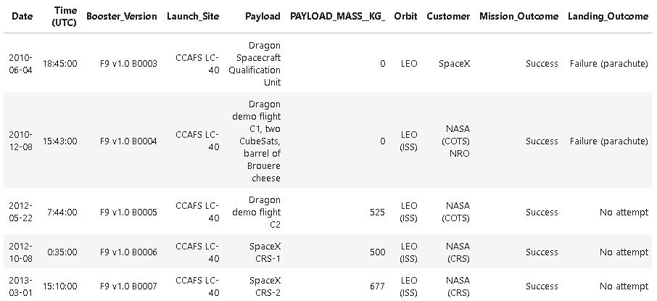
Launch Site Names Begin with 'CCA'
Find 5 records where launch sites begin with `CCA`
Launch records found with site names beginning with CCA presented failure or no attempt.

Slide 26
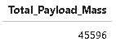
Total Payload Mass
Calculate the total payload carried by boosters from NASA
Total Payload Mass
45596 Kg

Slide 27
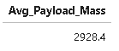
Average Payload Mass by F9 v1.1
Calculate the average payload mass carried by booster version F9 v1.1
Average Paylod Mass by F9 v1.1:
2928,4 Kg

Slide 28
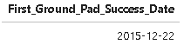
First Successful Ground Landing Date
Find the dates of the first successful landing outcome on ground pad
First successful ground landing occurred in 22 december 2015.

Slide 29
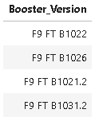
Successful Drone Ship Landing with Payload between 4000 and 6000
List the names of boosters which have successfully landed on drone ship and had payload mass greater than 4000 but less than 6000
4 Boosters with payload mass greater than 4000 but less than 6000.

Slide 30
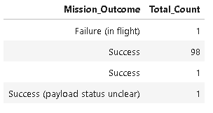
Total Number of Successful and Failure Mission Outcomes
Calculate the total number of successful and failure mission outcomes
Mission success 98% rate.

Slide 31
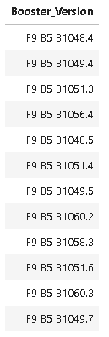
Boosters Carried Maximum Payload
List the names of the booster which have carried the maximum payload mass
%%sql
SELECT DISTINCT "Booster_Version"
FROM SPACEXTABLE
WHERE "PAYLOAD_MASS__KG_" = (
SELECT MAX("PAYLOAD_MASS__KG_")
FROM SPACEXTABLE
);

Slide 32
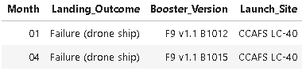
2015 Launch Records
List the failed landing_outcomes in drone ship, their booster versions, and launch site names for in year 2015
Failed landing identified in the database.

Slide 33
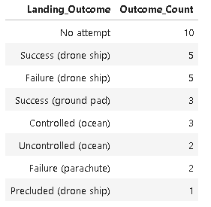
Rank Landing Outcomes Between 2010-06-04 and 2017-03-20
Rank the count of landing outcomes (such as Failure (drone ship) or Success (ground pad)) between the date 2010-06-04 and 2017-03-20, in descending order
Usual outcome is 50% chance of success landing.

Slide 34

Section 3

Slide 35

Folium Maps – Global Map Markers
Explore the generated folium map and make a proper screenshot to include all launch sites’ location markers on a global map
Lauch sites are always next to coastlines, east or west.

Slide 36
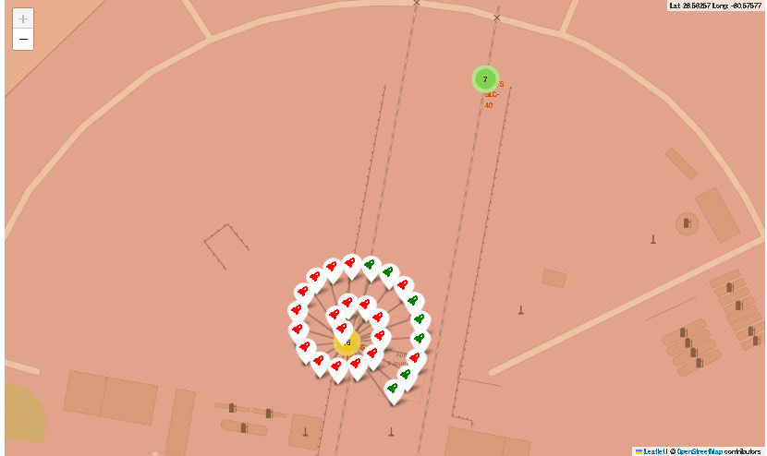
Folium Maps – Color-labeled launch outcomes
Explore the folium map and make a proper screenshot to show the color-labeled launch outcomes on the map
Green marker for failed launches.

Slide 37
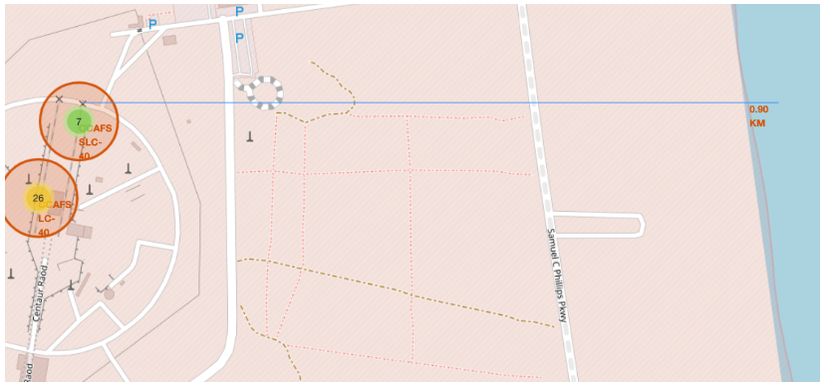
Folium Maps – Distance to coastline
Explore the generated folium map and show the screenshot of a selected launch site to its proximities such as railway, highway, coastline, with distance calculated and displayed
Distance from launch site to coastline: 0,90 km.

Slide 38

Section 4

Slide 39
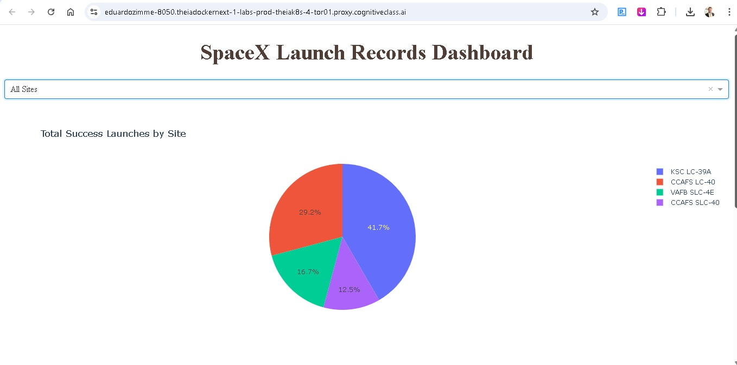
SpaceX Launch Records – All sites
Show the screenshot of launch success count for all sites, in a piechart
KSC LC-39A: 41,7% of total success launches.

Slide 40
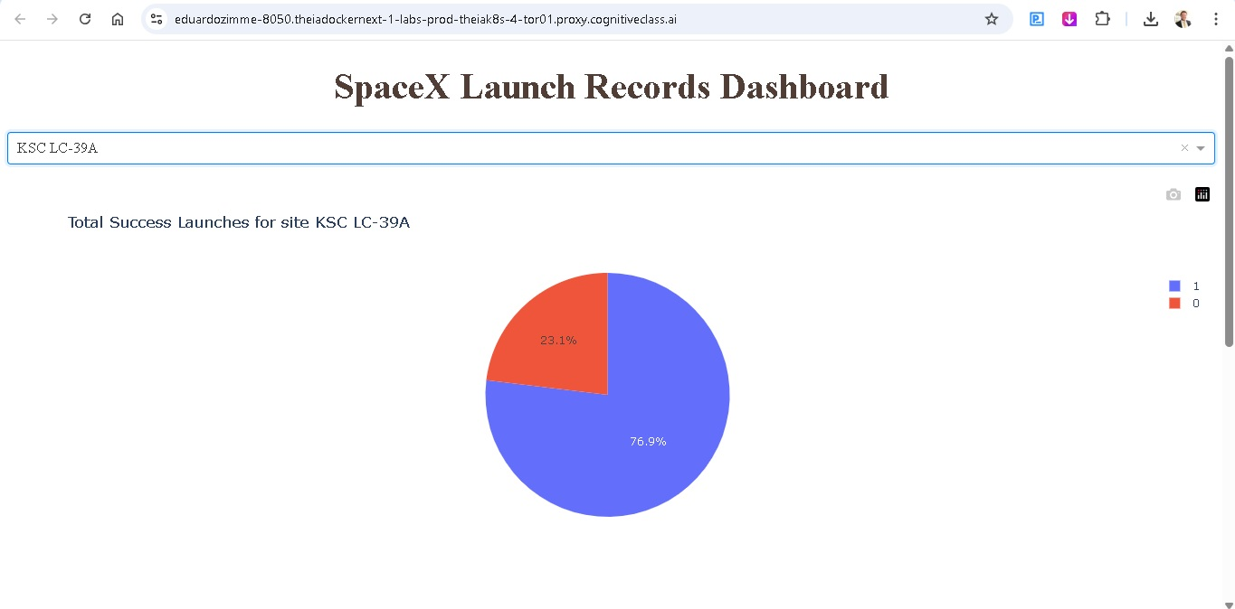
KSC LC-39A – success launch rate 76,9%
Show the screenshot of the piechart for the launch site with highest launch success ratio
Launch Success by Site (Pie Chart): KSC LC-39A achieved ~77% success.

Slide 41
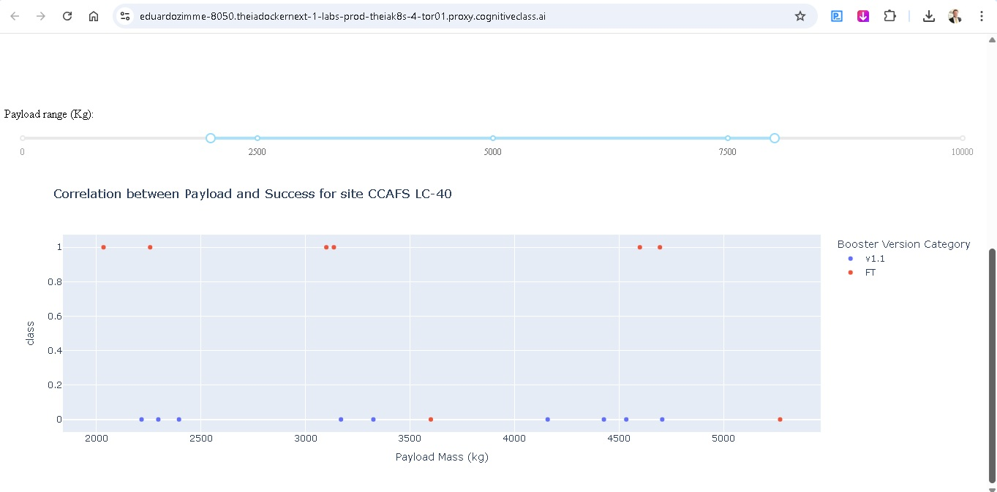
CAFS LC-40 – Payload range 2000 to 8000 (Kg)
Show screenshots of Payload vs. Launch Outcome scatter plot for all sites, with different payload selected in the range slider
Payload vs. Outcome Scatter (Interactive Slider): Certain payload ranges show higher probability of success.
Filters Enabled: Interactive selection by site, payload range, and booster version.

Slide 42

Section 5

Slide 43
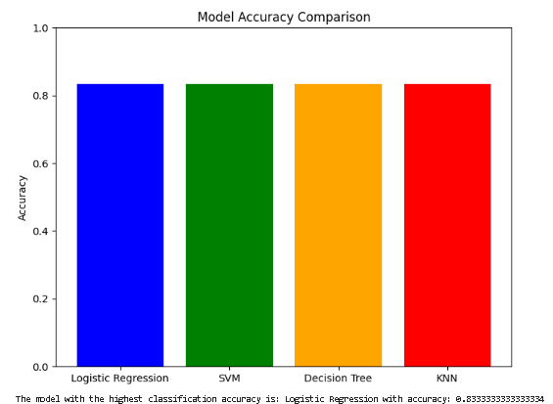
Classification Accuracy
Visualize the built model accuracy for all built classification models, in a bar chart
Models tested: Logistic Regression, Decision Tree, SVM, KNNLogistic Regression achieved the highest accuracy: 83.3%Other models (SVM, Decision Tree, KNN) performed similarly (~83%), but not betterLogistic Regression was selected as the final model for interpretation
Find which model has the highest classification accuracy
Logistic Regression: 83,33%

Slide 44
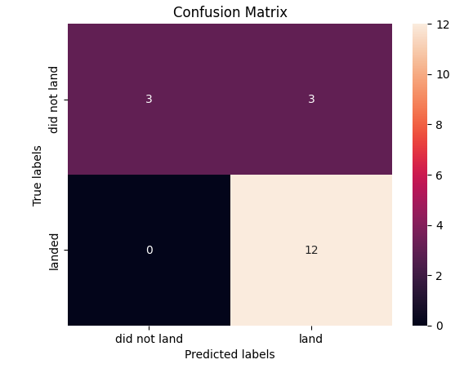
Confusion Matrix
Show the confusion matrix of the best performing model with an explanation
Strengths:Perfect recall for successful landings (no false negatives)High precision on positive outcomes (landed)
Weaknesses:Some false positives: predicted “land” when booster did not land (3 cases)
Interpretation: Model is more reliable at confirming successful landings than predicting failures.

Slide 45
Conclusions
Findings Recap:
Mission success strongly influenced by payload mass and launch site.
Success rate steadily improved over time.
Interactive tools (Folium, Dash) enhance understanding of spatial and contextual factors.
Predictive modeling achieved reliable performance (Logistic Regression best).
Implications:
Provides a foundation for decision-making on mission planning and risk assessment.
Framework can be extended with more granular engineering and environmental data.
Next Steps:
Expand dataset with new launches.
Experiment with deep learning for predictive modeling.
Deploy dashboards for real-time monitoring.

Slide 46
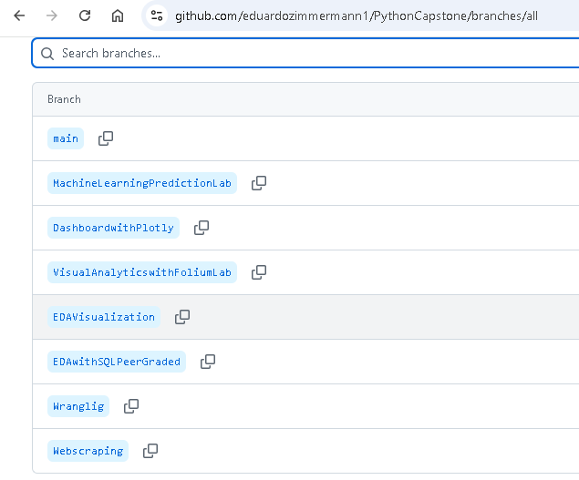
Appendix
GitHub Repo and view of all branches.

Slide 47


